Slide 1
COVID-19 AWARENESS ENSE885as project
HO CHI
200436599

Slide 2
content
Background and motivation
Statistics and community orientations
Sustainable Development goals
Project scope
Project requirement

Slide 3

Background and motivation
From November 2019 , 165,340,621 corona cases and 3,426,187 deaths
222 countries and over 100 variants

Slide 4
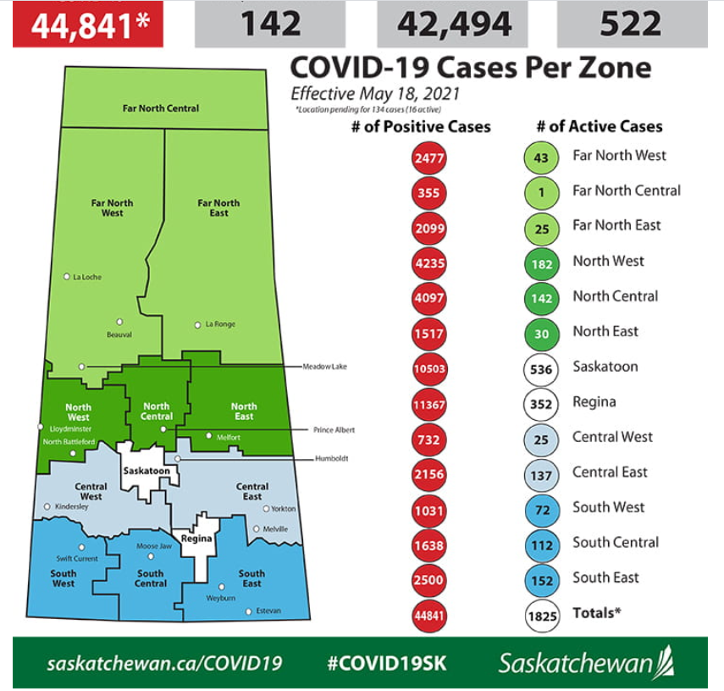
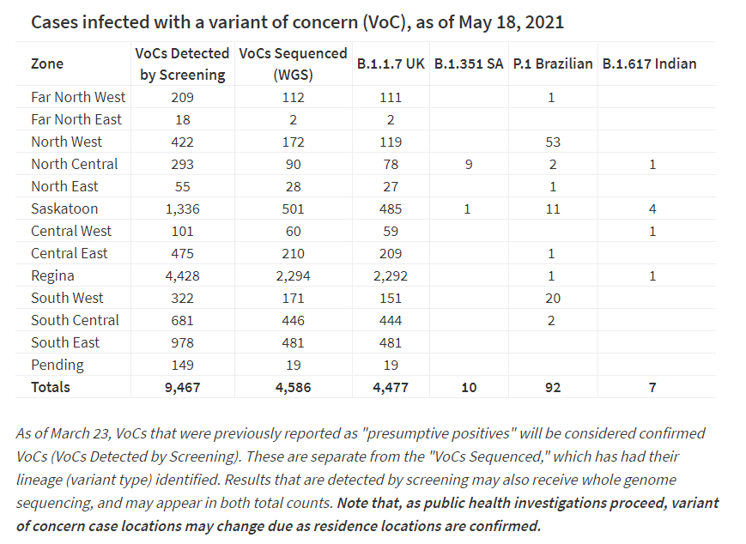
Statistic in community

Slide 5


Sustainable Development goals

Slide 6
Community orientations
Updating official news for Users
Provide users the basic background (Symptom of Covid-19, the precautions for Covid-19 or Coronavirus Cases statistic in the area they are living)
Updating the statistic related to user’s area

Slide 7
Project scope
Functions required:
LocationRequest
QuizzComponents
Database
GraphPage
ChatScreen
NewsPage

Slide 8



Constrains

Slide 9


